Slide 1
Internship project presentation
Web Development​

Slide 2
Savish - a Multipage responsive website
Introduction​
Technology used
​About Project
Snapshots
​Summary​

Slide 3
Introduction
Savish is a multipage responsive website built using frontend technologies like HTML, CSS and JavaScript. The UI of this website is built keeping in mind the basic functionalities a non-tech user might find useful while interacting with the webapp/website.
It is a project that helps to enhance the frontend web development skills and understanding the basic concepts of how internet works and how these websites are deployed over the internet providing with the help of version control tools such as Git/GitHub. Savish is a website built for an educational institute, the same UI or Layout framework can be used for various domains such as a landing page, portfolio and other projects as well.

Slide 4
Technology used

Slide 5
HTML 5 (Hyper text Markup Language)
The Hyper Text Markup Language or HTML is the standard markup language for documents designed to be displayed in a web browser. It can be assisted by technologies such as Cascading Style Sheets (CSS) and scripting languages such as JavaScript.
Web browsers receive HTML documents from a web server or from local storage and render the documents into multimedia web pages. HTML describes the structure of a web page semantically and originally included cues for the appearance of the document.
HTML elements are the building blocks of HTML pages. With HTML constructs, images and other objects such as interactive forms may be embedded into the rendered page. HTML provides a means to create structured documents by denoting structural semantics for text such as headings, paragraphs, lists, links, quotes and other items. HTML elements are delineated by tags, written using angle brackets. Tags such as <img /> and <input /> directly introduce content into the page. Other tags such as <p> surround and provide information about document text and may include other tags as sub-elements. Browsers do not display the HTML tags but use them to interpret the content of the page.
HTML can embed programs written in a scripting language such as JavaScript, which affects the behavior and content of web pages. Inclusion of CSS defines the look and layout of content. The World Wide Web Consortium (W3C), former maintainer of the HTML and current maintainer of the CSS standards, has encouraged the use of CSS over explicit presentational HTML since 1997.[2] A form of HTML, known as HTML5, is used to display video and audio, primarily using the <canvas> element, in collaboration with JavaScript.

Slide 6
CSS 3 ( Cascading Style sheet )
Cascading Style Sheets (CSS) is a style sheet language used for describing the presentation of a document written in a markup language such as HTML or XML (including XML dialects such as SVG, MathML or XHTML).[1] CSS is a cornerstone technology of the World Wide Web, alongside HTML and JavaScript.[2]
CSS is designed to enable the separation of presentation and content, including layout, colors, and fonts.[3] This separation can improve content accessibility; provide more flexibility and control in the specification of presentation characteristics; enable multiple web pages to share formatting by specifying the relevant CSS in a separate .css file, which reduces complexity and repetition in the structural content; and enable the .css file to be cached to improve the page load speed between the pages that share the file and its formatting.
Separation of formatting and content also makes it feasible to present the same markup page in different styles for different rendering methods, such as on-screen, in print, by voice (via speech-based browser or screen reader), and on Braille-based tactile devices. CSS also has rules for alternate formatting if the content is accessed on a mobile device.

Slide 7
JavaScript
JavaScript often abbreviated to JS, is a programming language that is one of the core technologies of the World Wide Web, alongside HTML and CSS. As of 2022, 98% of websites use JavaScript on the client side for webpage behavior, often incorporating third-party libraries. All major web browsers have a dedicated JavaScript engine to execute the code on users' devices.
JavaScript is a high-level, often just-in-time compiled language that conforms to the ECMAScript standard. It has dynamic typing, prototype-based object-orientation, and first-class functions. It is multi-paradigm, supporting event-driven, functional, and imperative programming styles. It has application programming interfaces (APIs) for working with text, dates, regular expressions, standard data structures, and the Document Object Model (DOM).
The ECMAScript standard does not include any input/output (I/O), such as networking, storage, or graphics facilities. In practice, the web browser or other runtime system provides JavaScript APIs for I/O.
JavaScript engines were originally used only in web browsers, but are now core components of some servers and a variety of applications. The most popular runtime system for this usage is Node.js.
Although Java and JavaScript are similar in name, syntax, and respective standard libraries, the two languages are distinct and differ greatly in design.

Slide 8
Other tools
Atom – An open source text editor which is multi-platform that allows cross-platform for your projects. It includes all the features you could ask for in a code editor, like a syntax highlighter, auto-detect for languages, automatic text completion, the possibility to use several panels and save your project to several folders, support for snippets, and a powerful search tool. The best feature is the modularity of the environment, to which you can add more features by installing extra packages. It also includes a control system for Git so you can publish your content using the GitHub platform.
Git/GitHub - Git is a free and open source distributed version control system designed to handle everything from small to very large projects with speed and efficiency. Its majorly used to publish every version of your project. Most of the times its used to deploy your projects over the internet. GitHub, Inc., is an Internet hosting service for software development and version control using Git. It provides the distributed version control of Git plus access control, bug tracking, software feature requests, task management, continuous integration, and wikis for every project.

Slide 9
About project
Savish – a complete multipage responsive website

Slide 10
Savish is an educational website that offers both professional educational courses as well as courses made to enhance your technical, behavioral and intrapersonal skills.
The website offers you some major undergraduate, postgraduate, Adult learning and Degree completion courses.
Savish ties up with some prestigious institutes based out of Delhi, Hyderabad and Mumbai.
The UI allows you to navigate through various webpages across the website. When the user opens the website it first visits the HOME page which acts as a brief introduction about the website.
What the website is all about. The user can scroll through to know more about us.
It provides all the information in a single page such as what is Savish, what courses do we offer, what facilities we offer in our campuses and by that it also gives a glimpse of our various branches/campuses across the country.

Slide 11
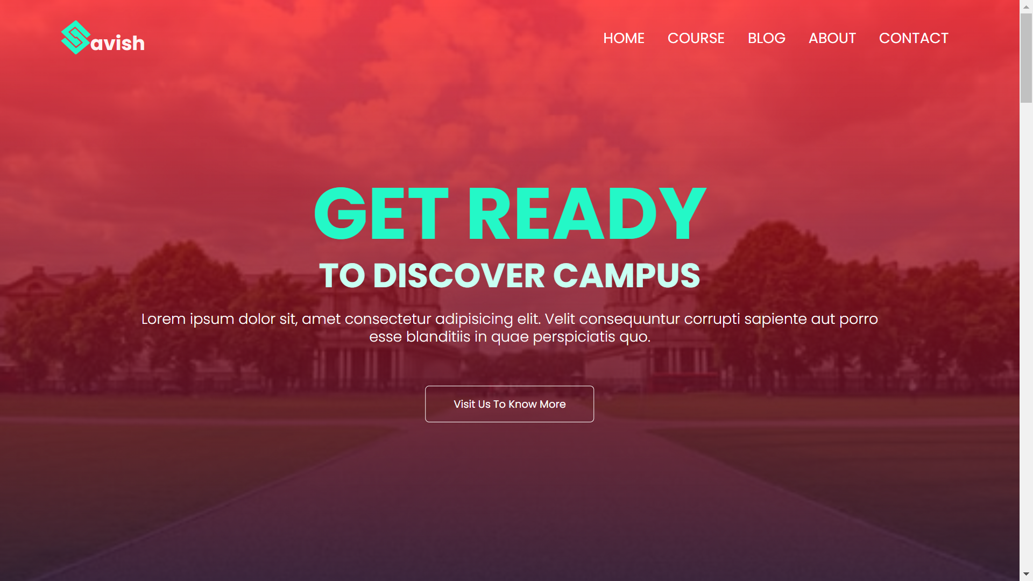
Home page
This is the first page or home page of the website.
The image is coving all the viewport in order to grab all the attention toward the website. The background image with a tint of gradient make the website more appealing and make the text pop-out which perfectly grabs all the user attention towards knowing more about us.
On top left there is a minimalistic logo of the company/institute. At same level there is a very simple but at the same time very elegantly designed navbar which allows you to navigate through multiple pages of the site.
*More images on next slide.

Slide 12
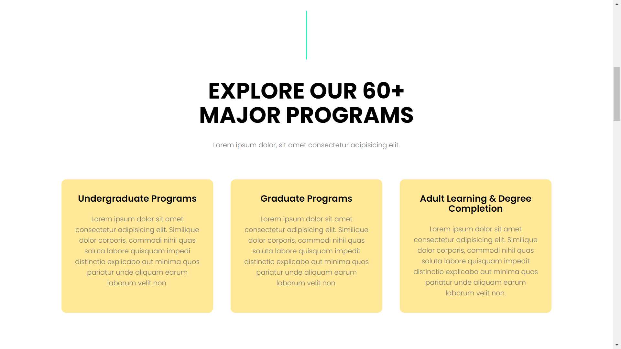
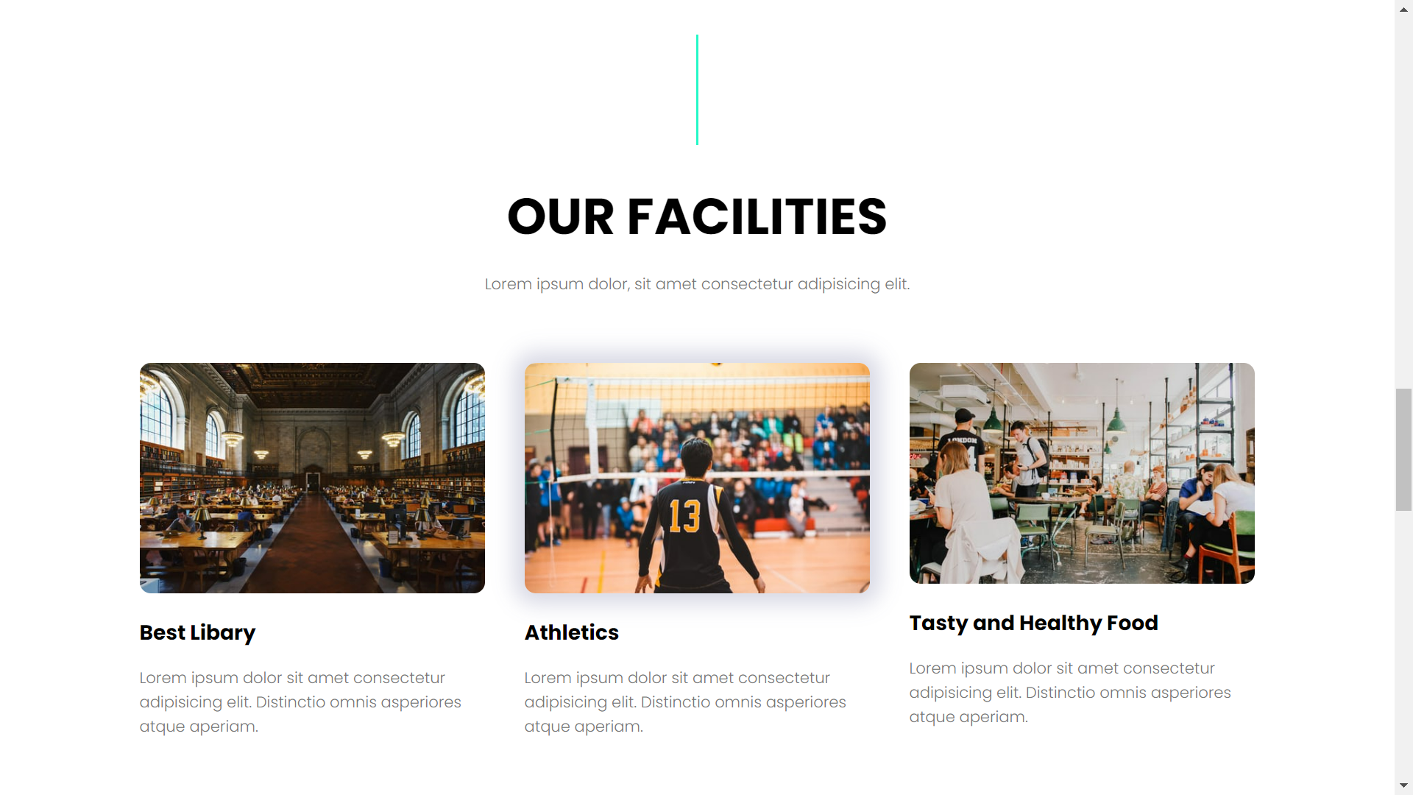
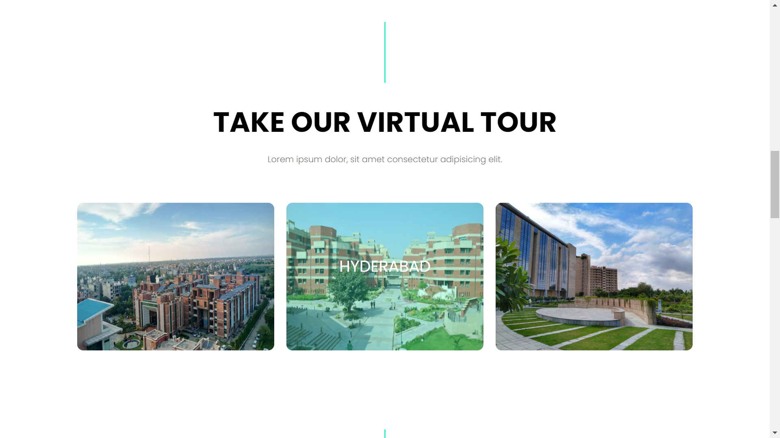
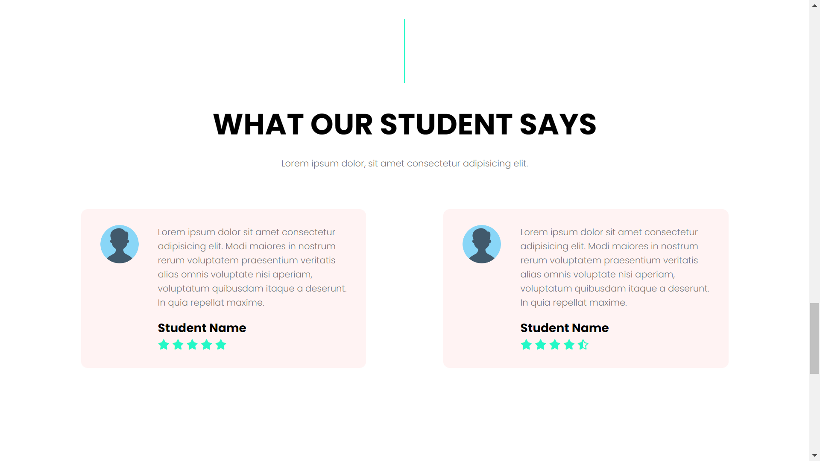

Slide 13

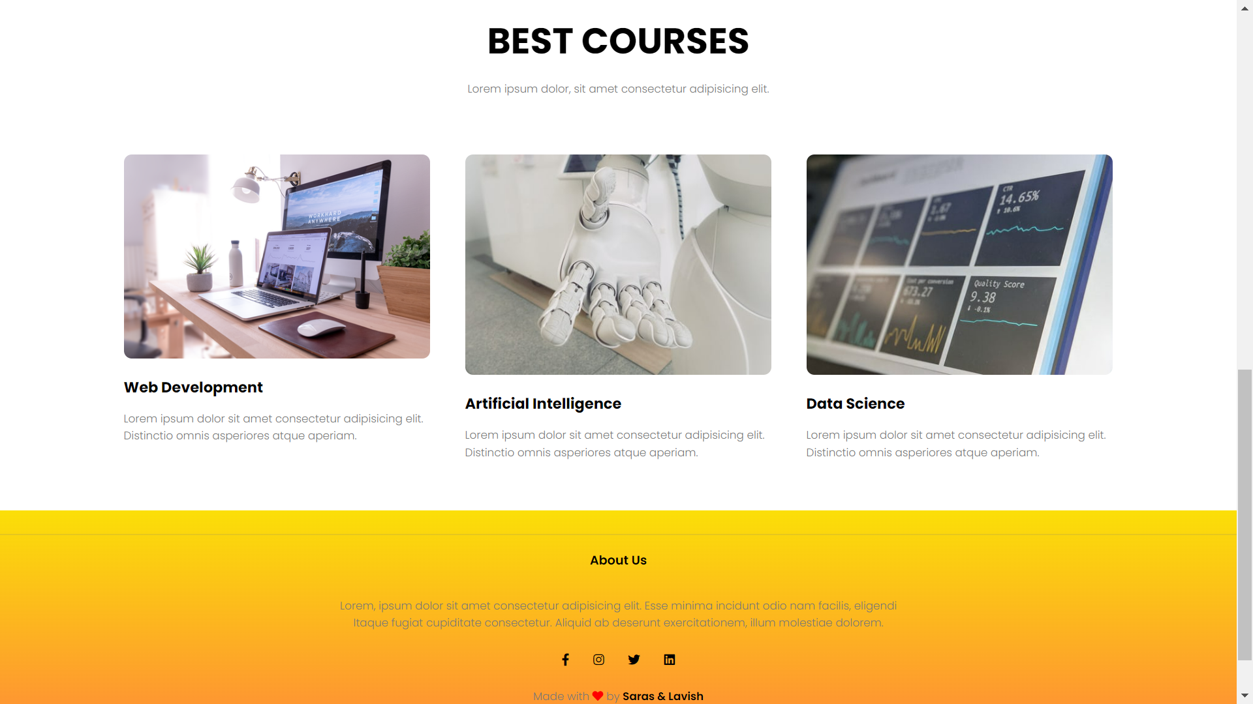
Courses Page
Courses page as the name suggests is made allow the user to have a glimpse of the courses we offer. It has mentioned some Undergraduate, Postgraduate and well as adult learning and degree completion courses that a person or more specifically a student is looking for.
Apart from that the page also lists some other skill enhancing industry ready courses that helps the students to uplevel their technical, behavioural and intra-personal development and grab their dream jobs in the industry.

Slide 14

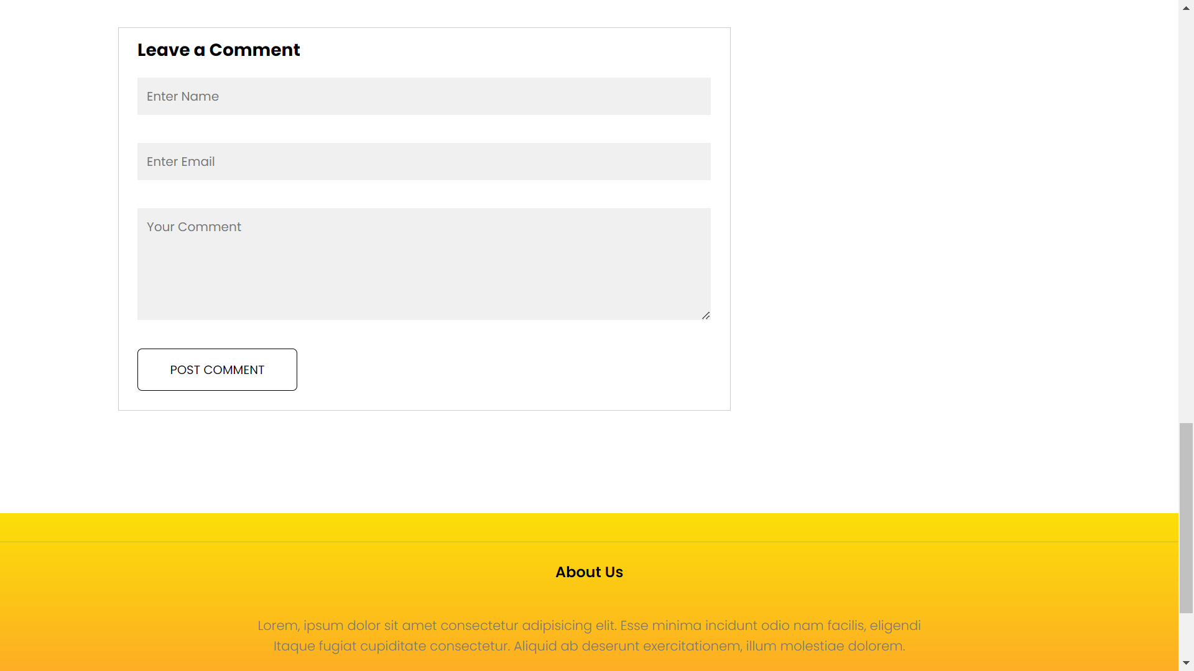
Blog page
Blog page highlight all the latest blogs written by the people or administrators of the institute. It generally list outs the categories on which the blog is written and a submission form which allows users to leave their valuable comments regarding the particular blog.

Slide 15

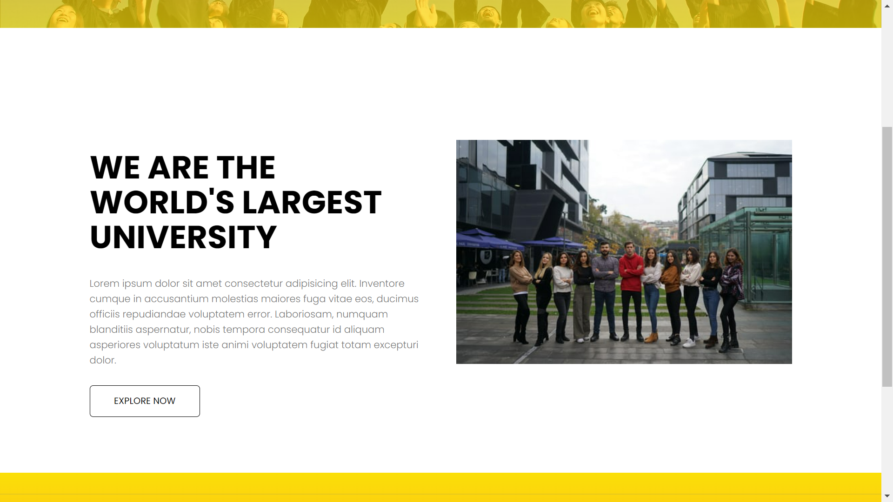
About us page
This is the About us page. It basically state about the Savish. It gives all the information that a person need to know about Savish like what is Savish, who are the people running these organisation etc.

Slide 16
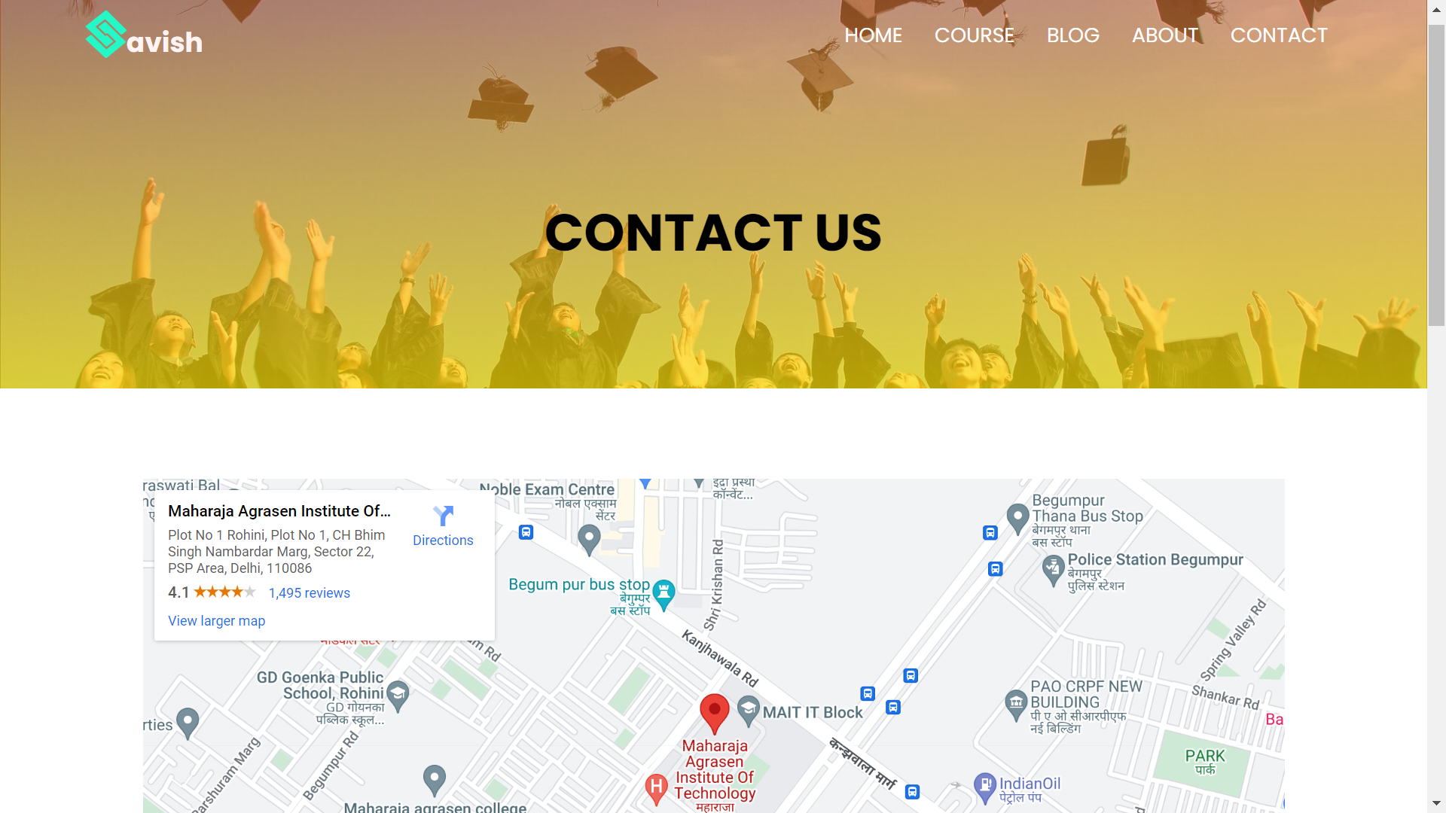
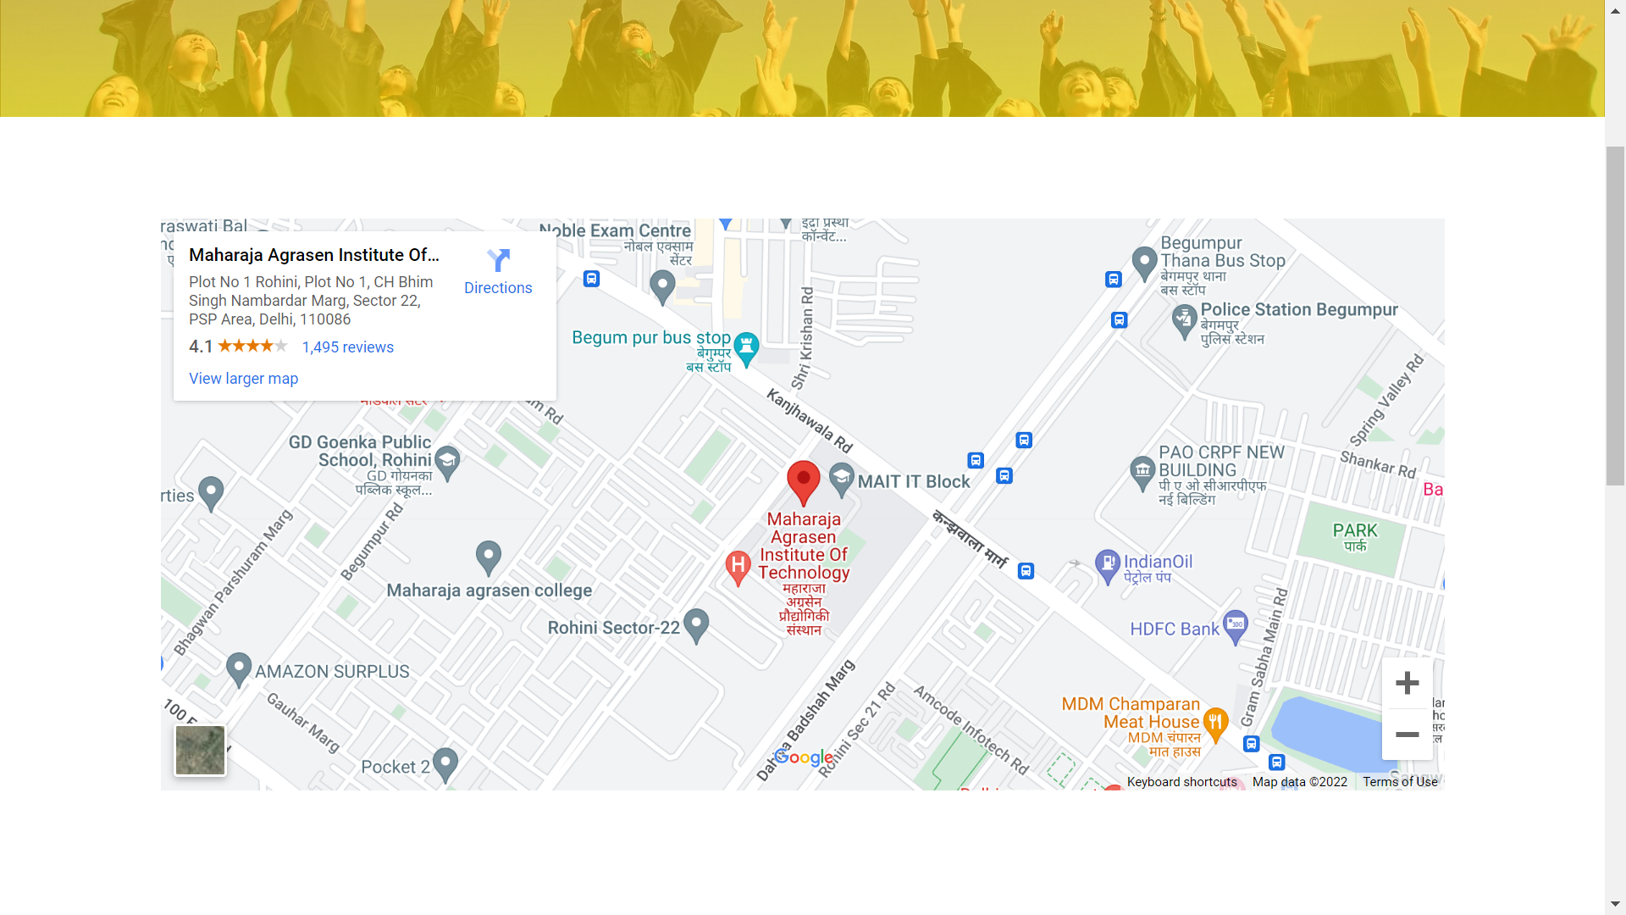
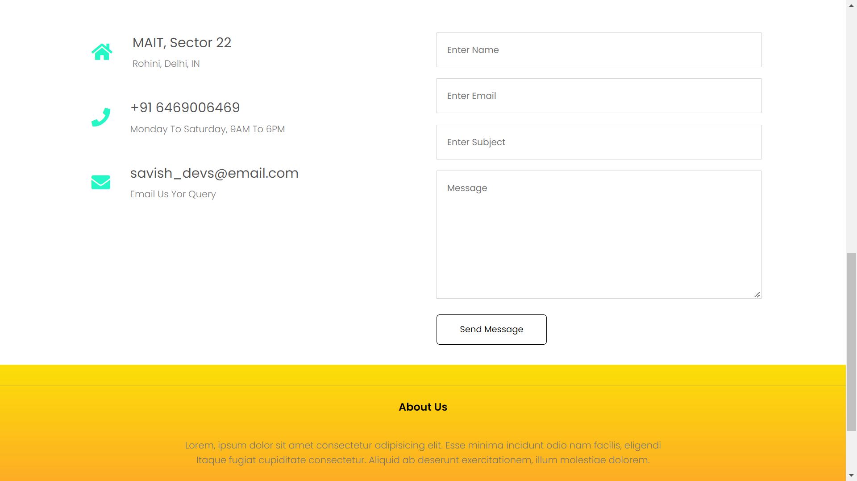
Contact us page
This page enlists all the contact details of the institute/ organisation such as the mailing address, physical address, phone number and also allow user to send their queries with the help of the form given on the page.
It also helps the users to navigate all to let them know the physical geographical location of the institute with the help of the map embedded on this page

Slide 17
SUMMARY
This is a multipage responsive website project built using frontend web technologies like HTML,CSS,JAVASCRIPT and the UI has been designed using FIGMA.
This is a demonstrative project which take up an educational institute website as an example. The same layout or framework can be used for creating similar kinds of multipage responsive websites for college projects, small businesses , portfolios etc.
The project has been made as a submission of internship at Exposys Data Labs in a 35 day period.

Slide 18
THANK YOU
Dheeraj Goyal
goeldhiraj1234@gmail.com
9812439030

